Slide 1

Module 1: Static Front End
Module 1, Week 1

Slide 2

What is front end?
It’s good to have a nice front end!
Stuff that happens on a browser.
HTML, CSS, JavaScript
API calls

Slide 3

What is “static?”
It’s not this.
One solid document
No variables
Unchanging

Slide 4

What is HTML?
Gives a webpage its structure
CSS and JavaScript need HTML
Conveys meaning to web crawlers and screen readers

Slide 5
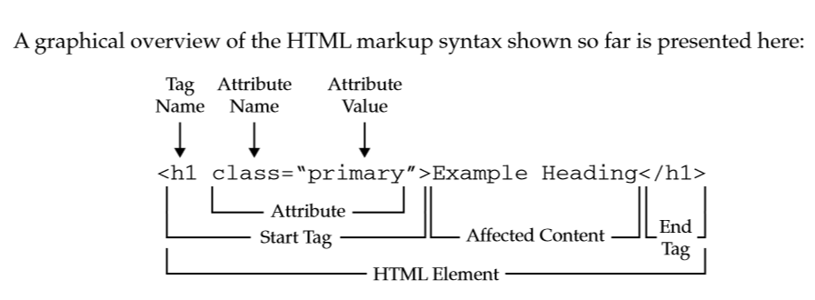
Parts of an HTML element

Slide 6
Block-level vs inline
Block elements will take up the full width of your viewport as a default.
Inline elements will take only the space they need, won’t create a line break.
Block-level elements
<h1>, <h2>, <h3> <ol>, <ul>, <li> <p>, <div>
Inline elements
<span> <strong>, <em> <img> <a>

Slide 7
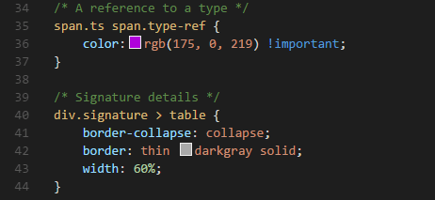
What is CSS?
Affects only appearance of web page
Called cascading style sheets because of the way selectors work
Can be written in HTML document, but best practice is to be written in a separate doc

Slide 8
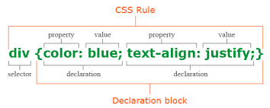
Anatomy of a CSS rule

Slide 9

Let’s start coding!

